Slide 1

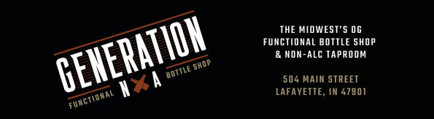
Sip Happens: The Rise of Alcohol-Free Cool on Campus
In Collaboration With

Slide 2

Meet The Brand
AND
What They
Do?
Midwest’s first non-alcoholic bottle shop, based in downtown Lafayette. They offer 150+ zero-proof beverages—from craft beers to CBD-infused drinks— designed for sober-curious students and health-conscious consumers.

Slide 3



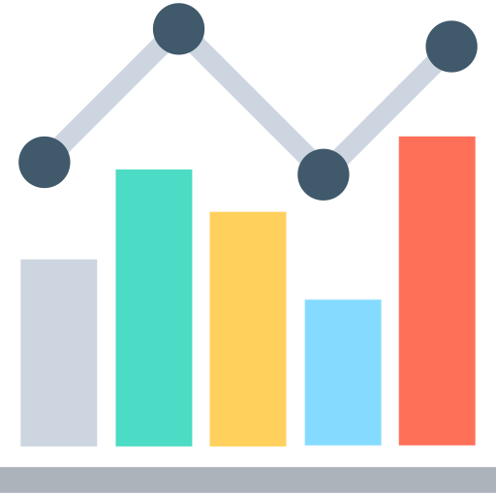
Cracking the Campus Code: What's Holding GenNA Back?
Midwest Pioneer
While being first gives a market edge, lack of category awareness in the region creates a need for continuous education and brand legitimacy. Many consumers still associate "drinks" with alcohol by default.
Proximity Drop-Off
GenNA’s food trucks on campus get great student response, but the downtown Lafayette store sees less footfall. It’s likely due to distance from campus, making in-store visits inconvenient despite high interest during pop-up events.
Unclear Market Size
With GenNA being a niche concept, a structured market survey is needed to understand how many residents in West Lafayette and Lafayette are genuinely interested in CBD-infused, alcohol-free, and wellness-oriented drinks—a prerequisite for growth planning.

Slide 4
Turning Clicks into Customers: How our Campaign Drives Real Impact
01
03
05
Addressing Awareness Gaps
Aligned messaging with academic identity and self-improvement, responding to student values like wellness, focus, and performance.
Tested different ad narratives (Hedonic vs. Utilitarian) to determine which resonates most with Gen Z students and motivates real action.
Driving Store Visits
Informing Strategic Planning
Targeted Purdue students directly on Instagram — where they spend time — helping bridge the brand recognition gap for this niche, emerging category.
Encouraged conversions via a “Free Sampler” CTA, designed to overcome friction caused by the store’s physical distance from campus.
Generated early signals and behavior insights to help validate the potential market and guide GenNA’s future outreach and scaling
02
04
Reframing the Message
Matching Student Psychology

Slide 5
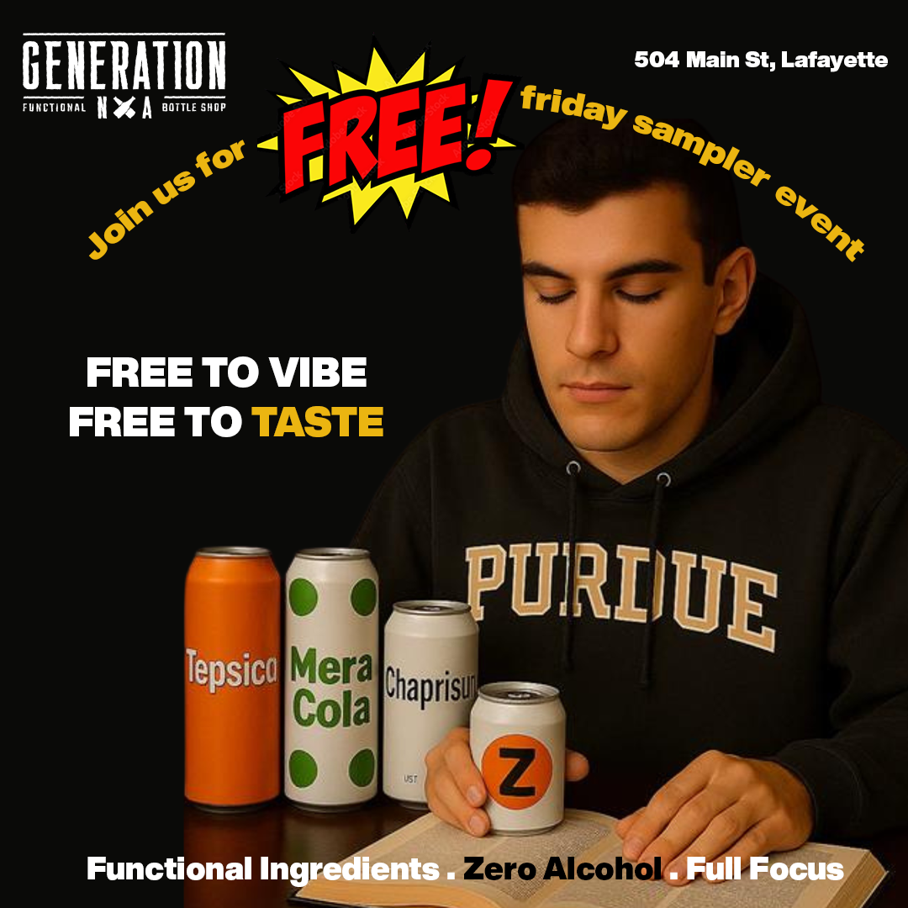
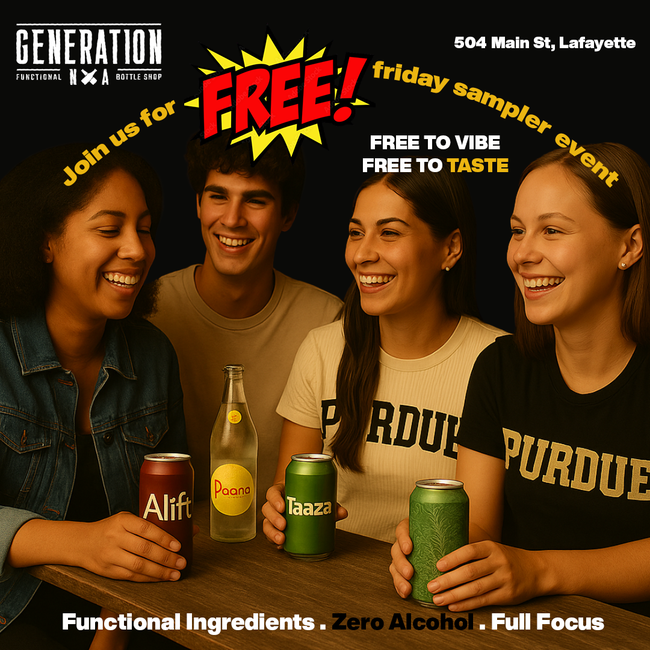
Solo Focus or Social Spark? The Hypothesis Behind the Creatives
Ad A (Functional, Utilitarian)
Ad B (Social, Hedonic)
H_{o}: The social appeal (Ad B) would have
Same CTR as focus (Ad A).
H_{a}: The social appeal (Ad B) would have
a different CTR as focus (Ad A).
Solo student enjoying functional benefits.
Focus on productivity and wellness.
Group setting highlighting fun and shared
experiences. Emphasizes social benefits.

Slide 6











The Right Audience, The Right Spend
Target Audience
Campaign Setup
Primary Segment: Gen Z students located in West Lafayette, Indiana
Duration: 10 Days (April 2025)
Psychographics:
Sober-curious and Wellness Focused
Value Functional benefits like focus, energy and relaxation
Seek alternatives to alcohol for health, academic, or lifestyle reasons
Total Budget: $100
Ad A (Functional Focus): $50
Ad B (Social Focus): $50
Platform: Instagram (Feeds, Reels, Stories, Explore)
Proximity: Campaign targeted users within 25 miles of campus
$100 total ($5/day per ad variant), CPC-optimized
Target Filters:
Age: 18-50
Interests: Non-Alcoholic drinks, health & wellness, student life, Purdue University
Devices: Mobile Users Only
Key Insight: Students were more responsive to individual benefit appeals (e.g., academic focus, functional ingredients.

Slide 7
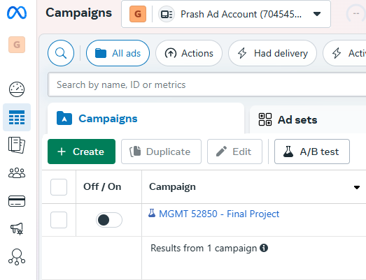
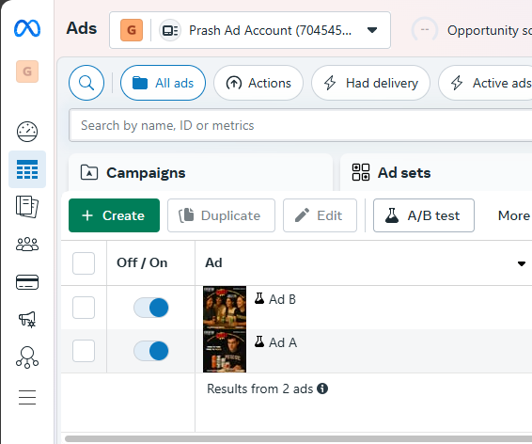
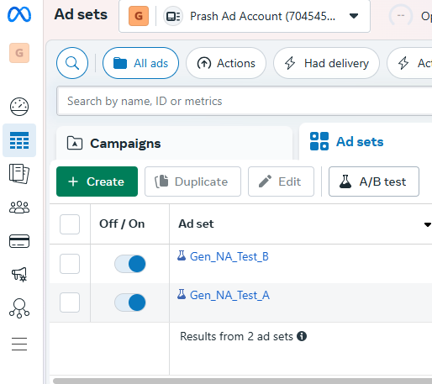
Campaign Structure
1 Campaign
2 Ad Versions
2 Ad Sets

Slide 8
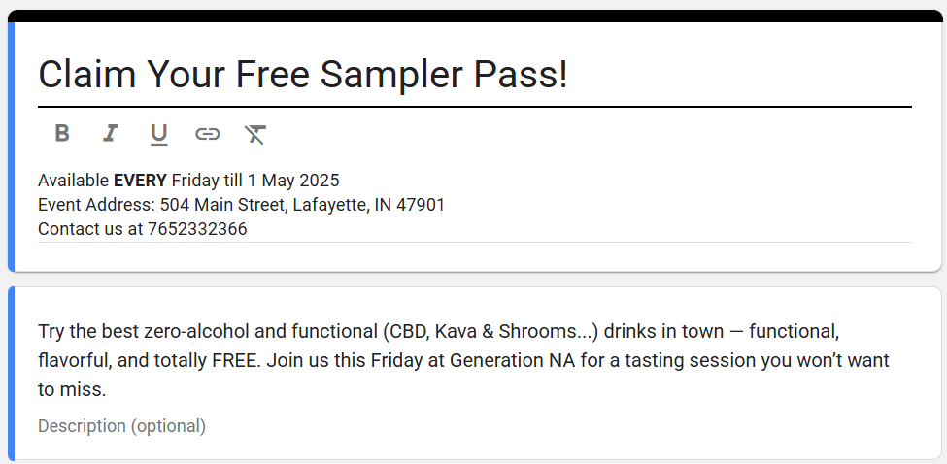
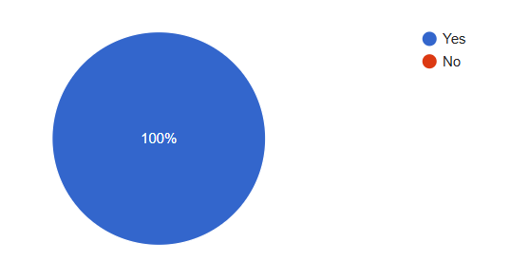
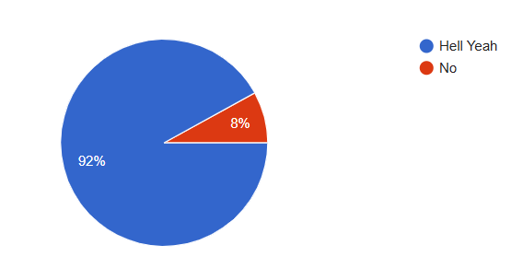
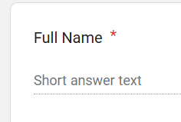
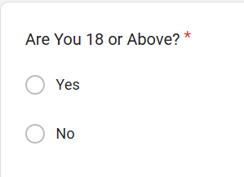
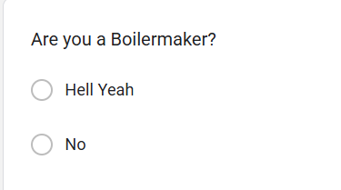

The Response Window: How Users Engaged with Our CTA
Form Purpose This quick form served as our primary call-to-action, collecting essential details to confirm event eligibility and student status for the Free Friday Sampler.
What We Learned
✅ 100% of respondents were 18+, confirming age
🧠 92% Purdue Students showed strong alignment with our target psychographic: wellness-curious Gen Z

Slide 9
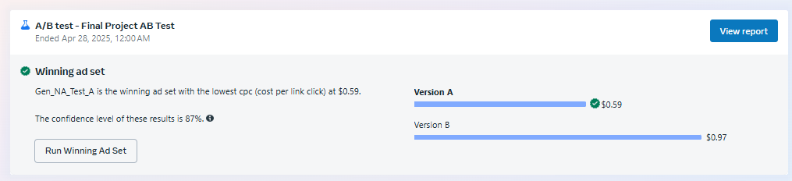
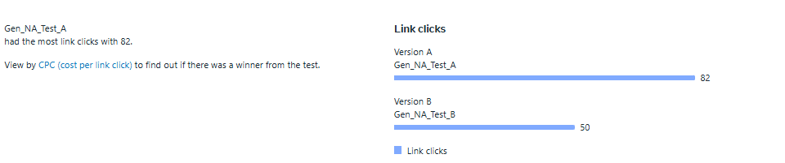
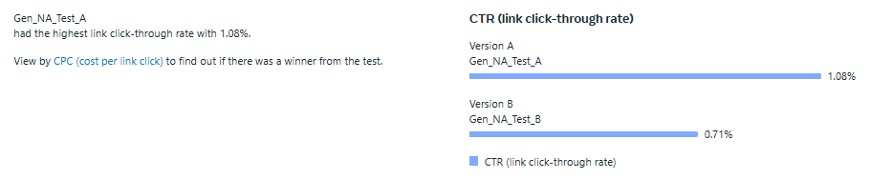
Results and Interpretation
Engagement and Interest
Ad A saw higher engagement (2.3% vs. 1.5%) and
CTR (1.07% vs. 0.74%), showing that functional,
individual benefits resonated better with audience.
Conversion Effectiveness
Ad A not only drove more traffic (88 clicks vs.
57 clicks) but also converted at a higher rate,
suggesting that the functional benefits created
stronger motivation to attend the event.
Efficiency
Ad A was more cost-effective with a CPC of
$0.60 compared to Ad B's $0.92, resulting in a
much lower CPA.

Slide 10

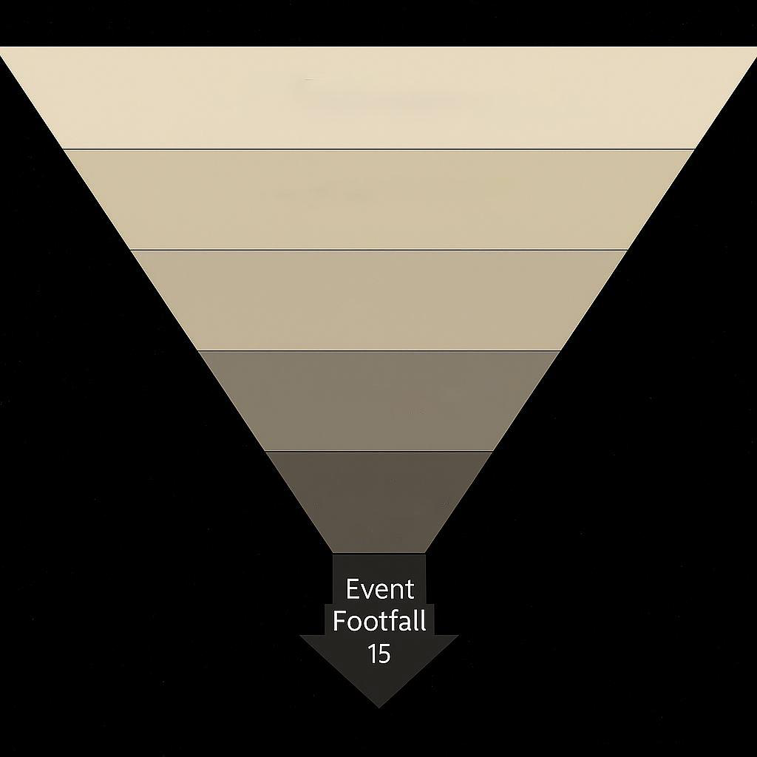

Conversion Funnel
We targeted 250,000 people were through Meta’s ad platform
Generated 15,917 impressions at a low cost of $0.006 per impression
Reached 6,973 unique users, with a cost per reach of $0.014
Secured 294 engagements across both ads ($0.34 per engagement)
Achieved 145 link clicks to the landing page ($0.72 per click)
Collected 25 form submissions from interested users ($4 per submission)
Drove 15 verified in-store visits, with a cost of $6.70 per attendee
Audience Size
250,000
Impressions
15,917
Reach
6,973
Interactions
294
Link Clicks
145
Event
Footfall
15

Slide 11
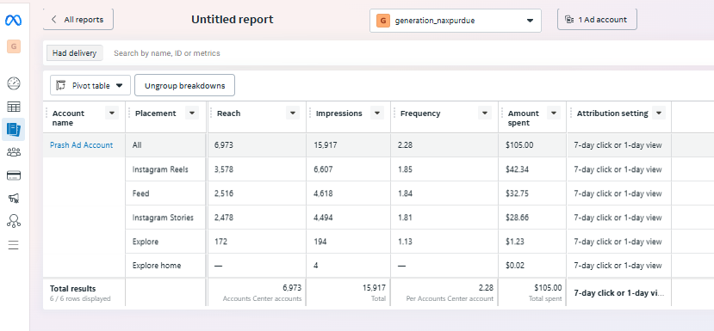
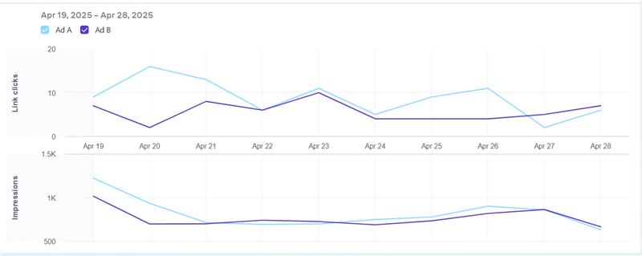
Key Findings and Insights
Ad A Insights
Early Spike & Volatility: Peaked at ~15 link-clicks on Apr 20 from ~800 impressions (CTR ≈1.9%), then fluctuated between 6–13 clicks thereafter.
Mid-Campaign Lull: Dipped to 6 clicks on Apr 24 and just 4 clicks on Apr 27 despite ~600 impressions- sign of ad fatigue.
Ad B Insights
Steady Engagement: Hovered in a tighter band (5–11 clicks) with a peak of ~11 on Apr 23 (700 impressions; CTR ≈1.6%).
Late-Campaign Uptick Modest rise in clicks toward Apr 28 as impressions ticked back up.

Slide 12
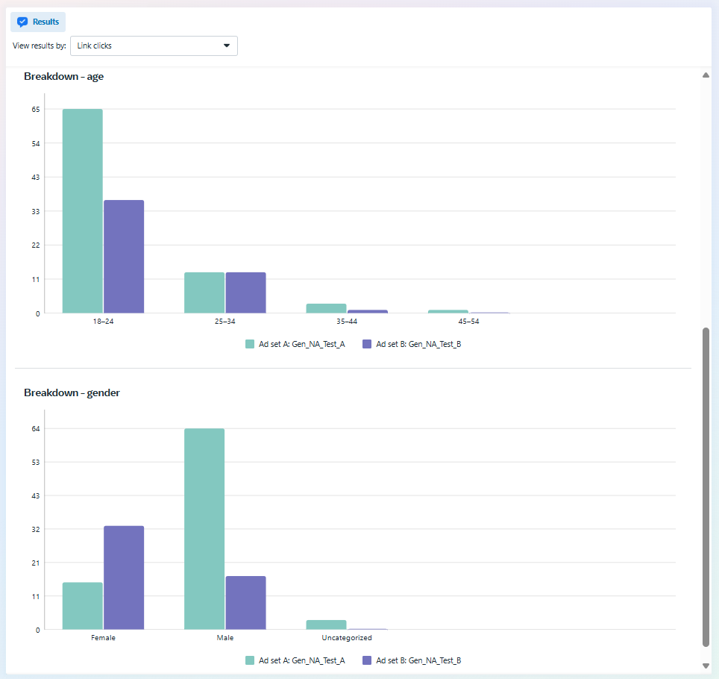
Key Findings and Insights
Ad A - Demographic Insights
Age: Over 80% of its 81 link-clicks came from 18–24 year-olds (≈65 clicks), with negligible traction beyond 25, suggesting its messaging strongly resonates with the youngest cohort but fails to engage older segments.
Gender: Clicks skews heavily towards male (≈65 vs 15 female), signaling a need to tweak creative or targeting to boost female engagement.
Ad B- Demographic Insights
Age: Roughly 60% of its 47 link-clicks also came from 18–24 year-olds (≈35 clicks), with a healthier tail in 25–34 (≈12 clicks) indicating broader age appeal than Ad A.
Gender: Clicks leans towards female (≈32 vs 15 male), showing this variant resonates more with women; consider shifting budget toward female-heavy audiences and testing tweaks for male viewers.

Slide 13
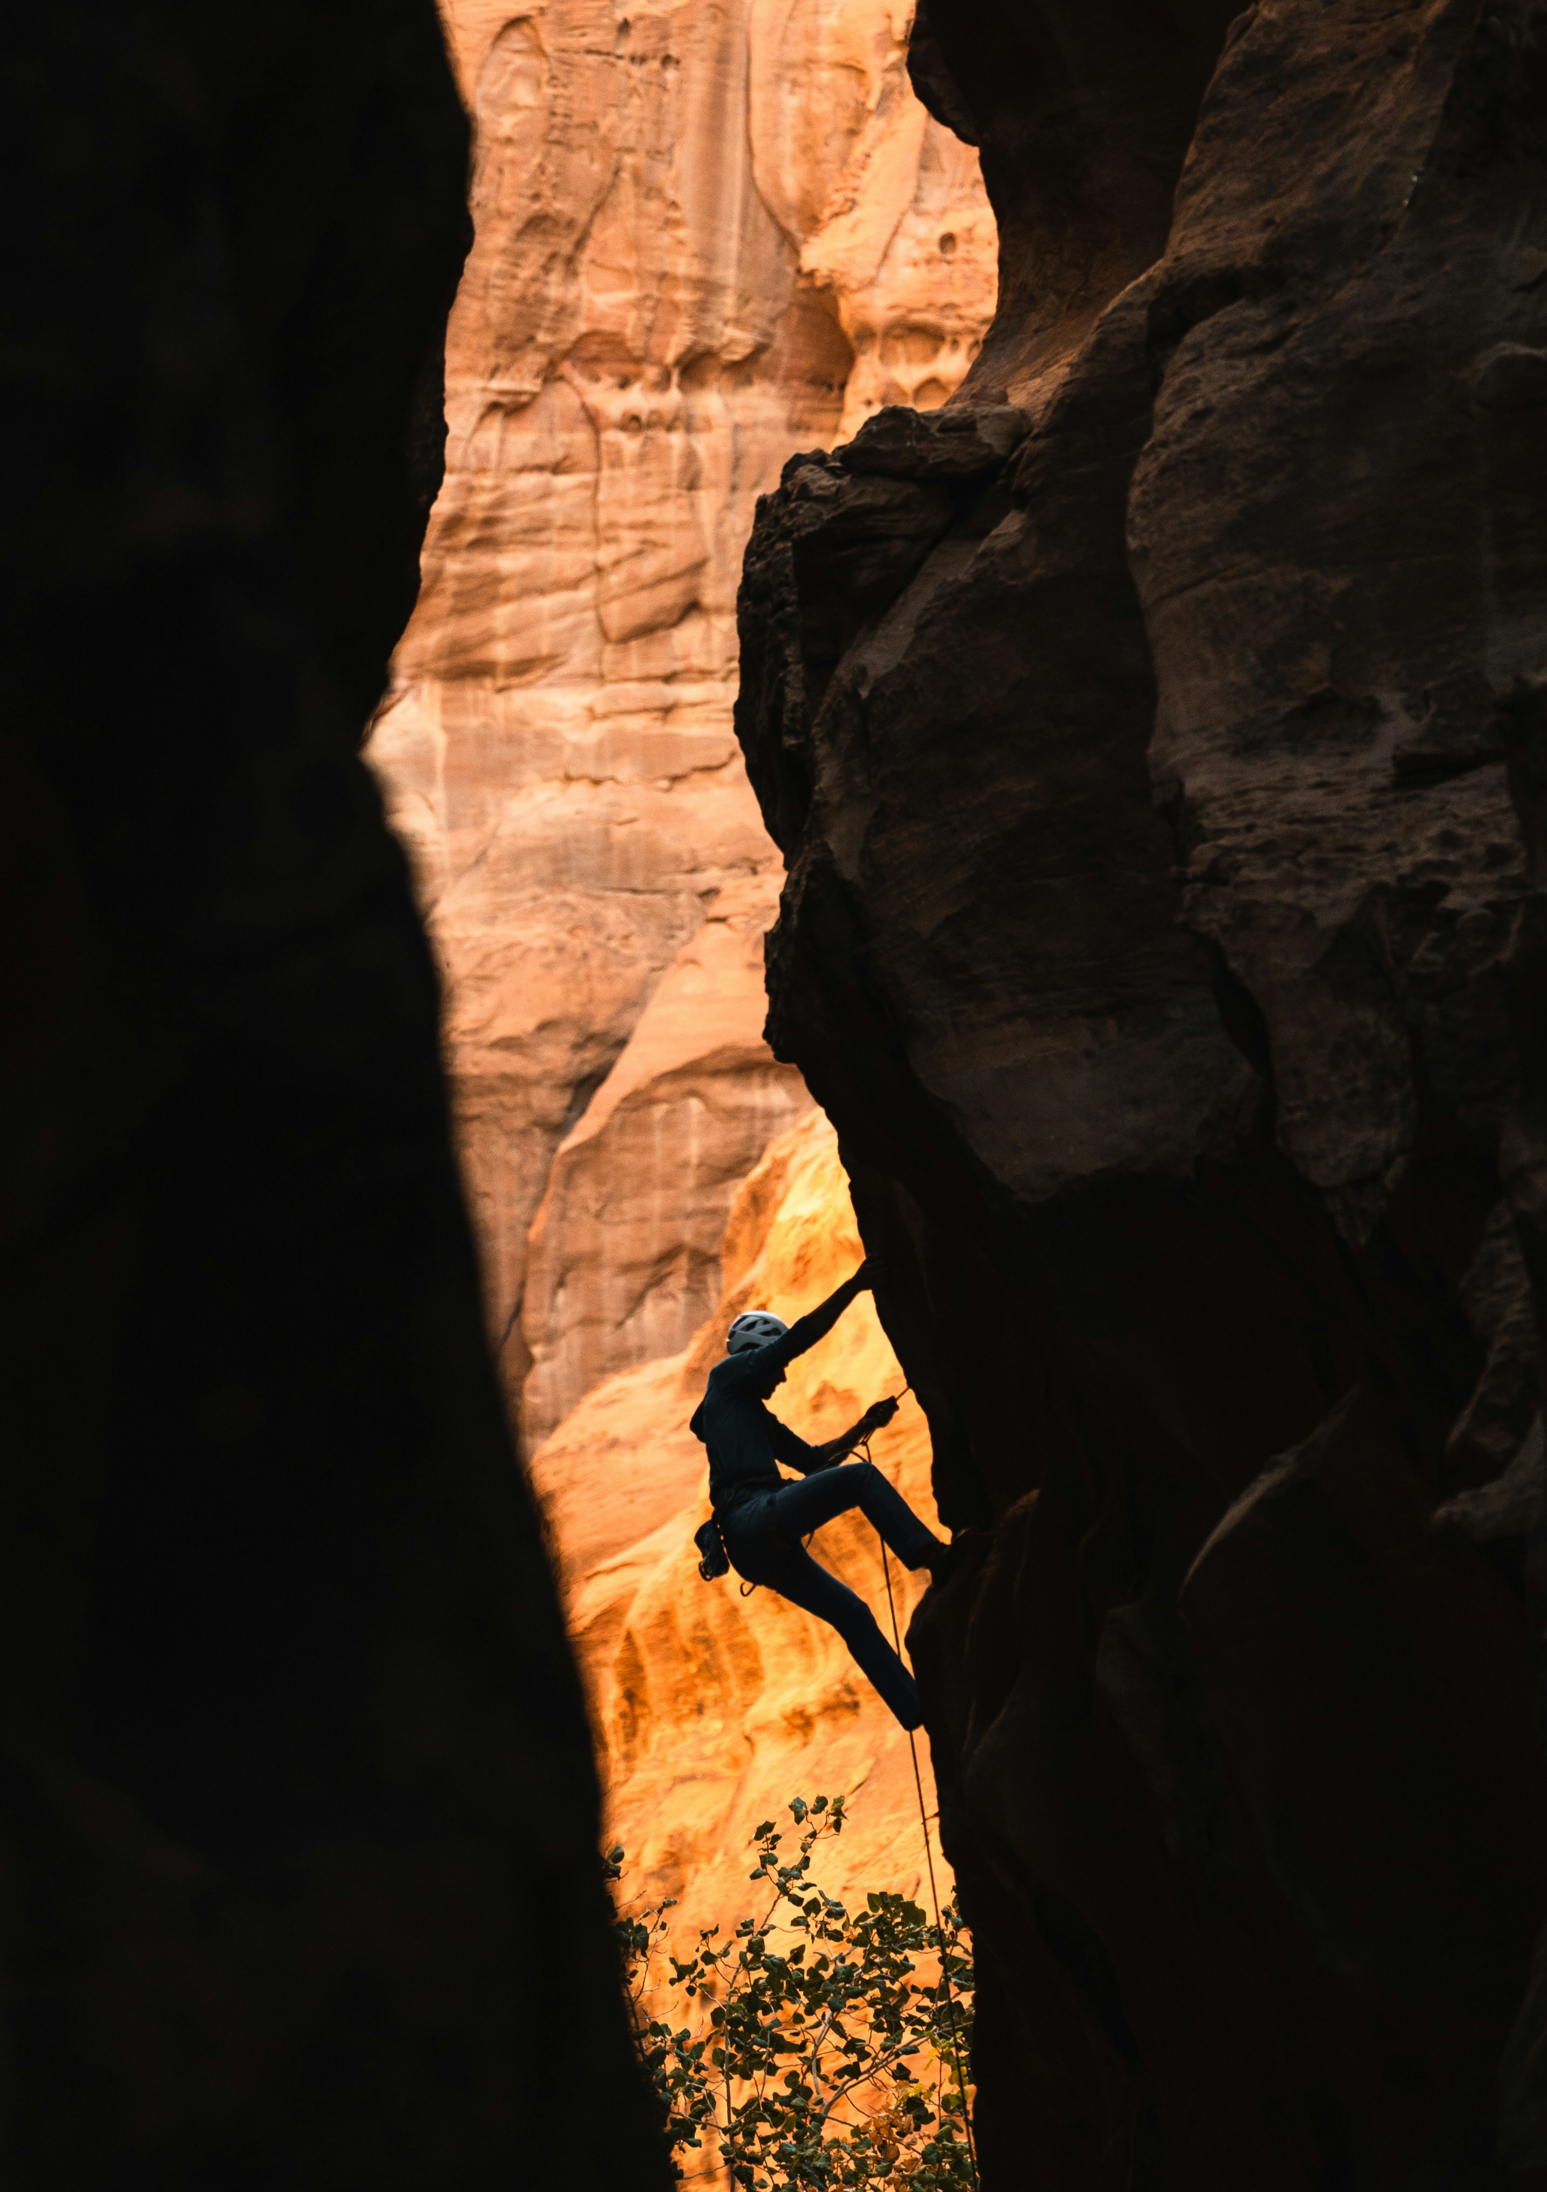
Challenges and Limitations
Ad Rejection Due to Content Guidelines
Meta flagged ads mentioning “alcohol” or “non-alcoholic,” causing delays,
multiple revisions limiting how clearly, we could describe the product category.
Narrow and Specific Target Audience
Targeting only Purdue students limited reach, reduced data for analysis,
and made findings harder to generalize beyond campus.
Form Drop-Offs and Tracking Limitations
Some forms were incomplete, and store visits couldn’t be fully tracked
without user confirmation.
Brand Awareness Baseline Was Very Low
Low brand awareness led to confusion or skepticism; stronger pre-campaign
buzz was needed.

Slide 14



Recommendations & Next Steps
Emphasize Functional Benefits
Test Multiple Platforms
Introduce Referral Incentives
Highlight ingredients, focus, and wellness advantages. Connect products to academic success.
Use academic or study-related visuals to reinforce the connection between product use and improved student life outcomes.
Expand future testing to TikTok and Snapchat, which are widely used by college students.
Run retargeted ads to re-engage users post-click and encourage them to complete the desired action.
Leverage peer influence by allowing users to invite friends for perks (e.g., “Bring a friend, get a free sampler pack”).
Coupons for attendees to bring a friend for an additional discount on the next visit.

Slide 15


